Slide 1
A vision… and ambition…
A potential single web-based ‘system / sector level’ platform to reduce friction and make the energy, water, and waste sectors the easiest to do business with…
POC WIP DRAFT – Note File Name Shows Version

Slide 2
Introduction
POC WIP DRAFT
This slide deck is iterative and drafted to inform a potential ITT, the first iterative version was dated ‘281025’.
The work, engagement, and thinking captured, aggregated and represented is from March 2025 to the version date.
The captured, aggregated and represented content is from members, government, partners, and Energy & Utility Skills colleagues and Board members.
The purpose is to present an inclusive and transparent approach to the development of a potential ITT.
It is expected that this iterative approach will be completed after the meeting planned on 19.11, at which point a potential ITT will be drafted as set out in the ‘Timeline’ slide of this deck.
Note(s):
POC is proof of concept.
WIP is work in progress.

Slide 3
UK Wide Need
POC WIP DRAFT
DFE Northern Ireland
The Green Skills Action Plan action 2 is to establish a central information hub, action 8 commits to developing competency pathways for green sector occupations, action 11 focuses specifically on consistent and coordinated communications.
DESNZ
The Clean Energy Jobs Plan action 3.6 sets out the ambition for a sector attraction campaign, early work has determined that this campaign needs somewhere for curious and inspired talent to ‘land’. Action 3.8 sets out how Energy & Utility Skills will seek to pool talent. The plan states a commitment to provide up p to £20 million of funding from UK and Scottish Government to aid the transition of North Sea workers into clean energy sectors - this transition needs somewhere for talent plan and view their transition
DEFRA
The Water Skills Strategic Group has a workstream defined to shape a national ‘story’ to attract talent at a ‘system / sector’ level. This ‘story’ needs somewhere for curious and inspired talent to land.
Skills Development Scotland
Are promoting career pathways into new energy roles and enabling reskilling / transition of workers in declining industries. The route-map for the circular economy and waste focuses on talent attraction.
DWP
Through the Strategic Relationship Team there is a great opportunity to connect the 600+ Job Centres directly to the sector. This has to be simple and consistent. A platform is also needed should the ‘sector entry’ pilot be successful

Slide 4
Capabilities
POC WIP DRAFT
‘The’ system level sector attraction destination for energy, water, and waste ‘fed’ by member, endorsing partner, government and EUS Group web and social media promotion.
Careers advice for new entrants supported by case studies and influencer content (AI).
Automated role matching of candidates to suitable roles based on their skills and experience (AI).
Vacancy integration, alert candidates to relevant vacancies across the energy, water, and waste sectors (AI).
That talent can have an accurate assessment of their route to safety and competence for their chosen occupational profile and / or vacancy (AI).
Training integration for ambitious talent to find training that can help them to be more competitive and better prepared for a role (AI).
Occupational profiling integrated to enable a great career transition experience and reduce the complexity of job title / name variation (AI).
Direct link to all job centres to enable job centre ‘customers’ to be matched to role or sector entry cohort opportunities.
To provide a single and ‘frictionless’ destination for third sector organisations to work with potential talent and to support candidate attraction and recruitment to the sector.
To support talent create a digital profile / CV to register on the platform and be competitive in the talent pool. Profile / CV to potentially combine text, video and audio, and to capture completed training (AI)
The outplacement destination to support members retain talent within the energy, water, and waste sectors.
The destination for ‘regretted talent’ that is unsuccessful in an application to have a brilliant experience and to join the sectors largest talent pool.
A place for member recruiters to identify and locate talent and directly invite to selection processes (AI).
To host / direct to digital training packages that have been developed and made available to the sector (AI).
Partner advocacy and alumni network (AI).
A data rich platform that is secure and provides an unparalleled primary data source to inform workforce planning and support sector leading research (AI).

Slide 5

Energy & Utility Skills Partnership 2025-30 Skills Strategy Alignment
POC WIP DRAFT
Research |  | Attract |  | Develop |  | Retain
Strategy Actions Alignment
Research: Analyse candidate pipeline: Review the Energy & Utilities Careers & Jobs candidate pipeline, and see how it’s meeting future needs at a devolved level.
Attract: Improve sector perception: Deliver an awareness campaign to improve how people view a career in our sector’s industries.
Attract: Boost communications: Create a new ‘Sector Communications and Promotion’ network group that brings together communication leads, in an effort to coordinate and amplify messages.
Attract: Develop career resources: Test out new career resources based on occupational profiles with devolved governments, the Department for Work & Pensions, and The Careers & Enterprise Company.
Attract: Deepen key partnerships: Proactively engage with partners and government to support our members to attract and recruit a diverse workforce
Attract: Attract other sectors: Work with industries that have large workforces finishing major programmes, to help find and transfer talent into the energy and utilities sector.
Attract: Support inclusive recruitment: Increase outreach to underrepresented communities, as well as sector leavers, returners and retirees. This includes promoting more inclusive recruitment practices.
Develop: Test new entry model: Pilot a simple model to help new talent join the sector safely and become productive quickly.
Develop: Develop occupational profiles: Work closely with our members to develop detailed profiles for priority roles, establishing consistent standards across the UK.
Develop: Explore partnerships: Engage with energy and utility institutes and chartered institutes to find new ways of working together.
Develop: Introduce an occupational map: Create a comprehensive occupational map to clearly show possible energy and utilities career paths, the required skills and how people can progress.
Retain: Use workforce data: Review workforce data to ascertain the best actions to help keep more people in the sector.
Retain: Capture talent referrals: Introduce a talent referral programme that keeps skilled people in the sector, including unsuccessful candidates, as well as providing clear pathways for those moving across the energy and utility industries.
Retain: Take advantage of occupational mapping: Use job mapping to show clear career paths, and engage with retirees so they can help with transferring knowledge.

Slide 6
POC WIP DRAFT
Serving
Members shop window to citizens, partners, training providers and governments.
Industry as the sector attraction destination for energy, water, and waste.
Training providers connect directly to course dates and training opportunities.
Citizens to find a job, get training, be inspired, supported through challenging times.
Governments simplify the route into the sector.
Third sector organisations to simplify information sources, and routes into the sector.
Energy & Utility Skills further developing credibility, working together, and making a positive difference.
Making jobs (and lives) easier
Member recruiters the ambition to have the sectors largest talent pool.
Sector careers advisors great resources for schools to Job Centres.
Citizens simplifying the complex and reducing friction – answers and inspiration the fewest ‘clicks’ possible.
Training providers to fill up their courses and deliver their contracts.
Job centre coaches and leveraging the 600+ job centres and making it easy for coaches to meet their targets.
Third sector organisations a time and resource efficient platform to widen awareness, access and inclusion.
Researchers great primary data.

Slide 7
Funding
POC WIP DRAFT
Build Costs
Potential investment from the Energy & Utility Skills Group.
Potential member investment.
Potential government(s) and department(s) grant(s) / funding.
Ongoing Sustainability, Quality and Impact
Not accessible to non-members – stronger together.
Core member offer for all EUSP members, would see separate EUCJ model become obsolete.
Potential asset owner membership fund membership fees for supply chain.
Training provider sponsorship / payment to have flow through from site.
Government(s) and department(s) grant(s) / funding.

Slide 8
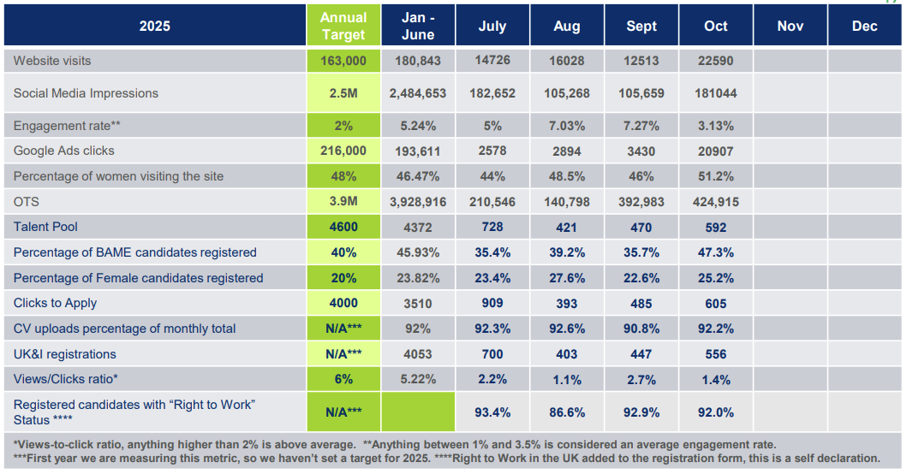
Current Performance – 2025 YTD Energy & Utilities Careers & Jobs at October 2025
The existing jobs capability (linked here) was first introduced in 2019.
Capability is limited and not used by all members.
Year to date talent pool is 6,583 unique individuals.
Performance and RoI measures for any potential investment would need to be defined as part of the planning and potential ITT preparation.
Based on the sector needing a minimum of 44,600* new people per annum the annual talent pool would need to significantly increase from those accessing the current limited capability.

Slide 9
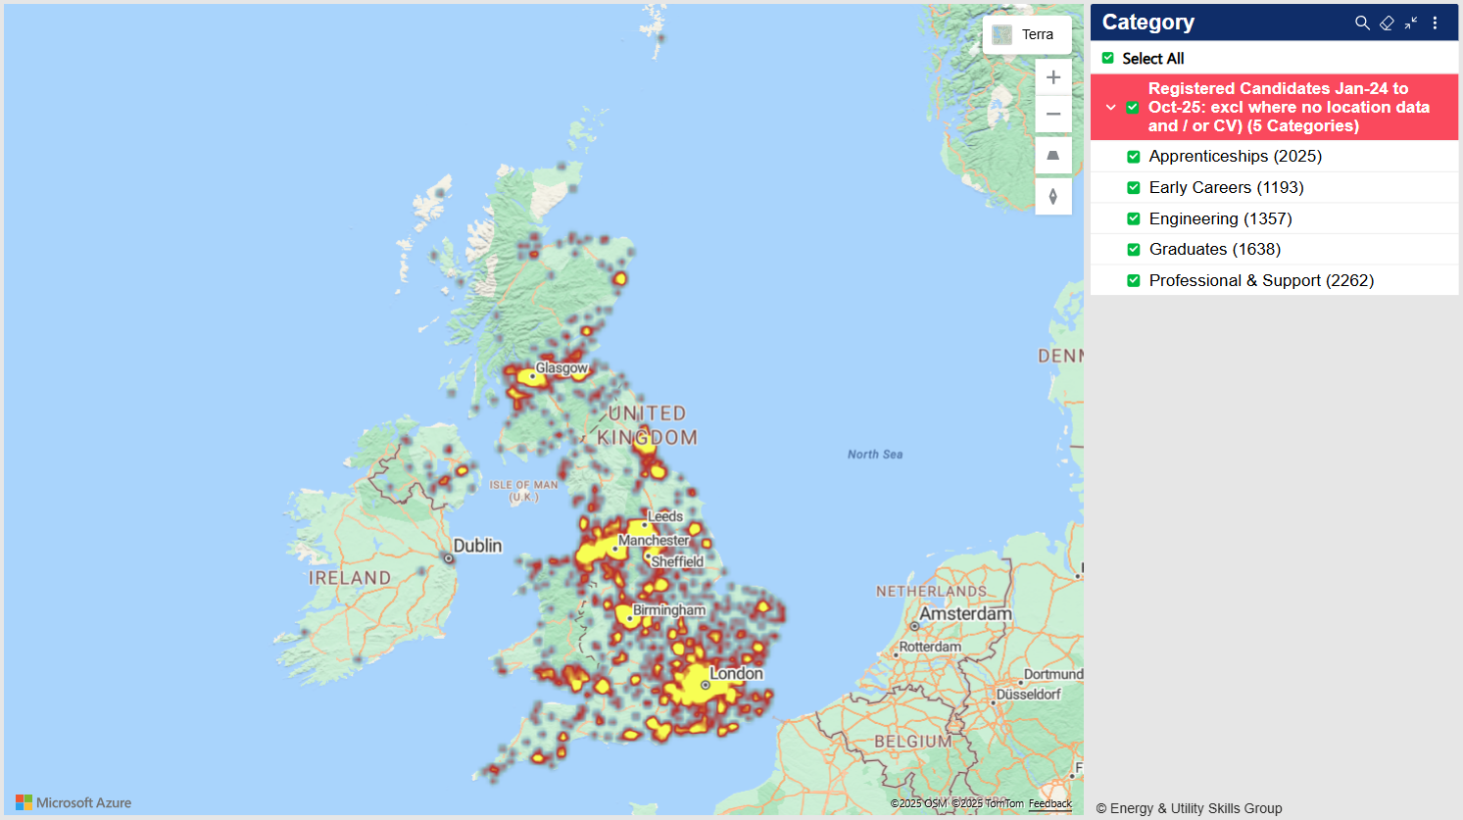
Current Coverage – Registered Candidates Jan-24 to Oct-25
8,475 registrations since 2024 that have location data.
Postcode was not a mandatory field until 2025 as such the 8,475 is predominantly made up of the 6,583 2025 YTD registrations.
UK wide reach and awareness demonstrated.

Slide 10
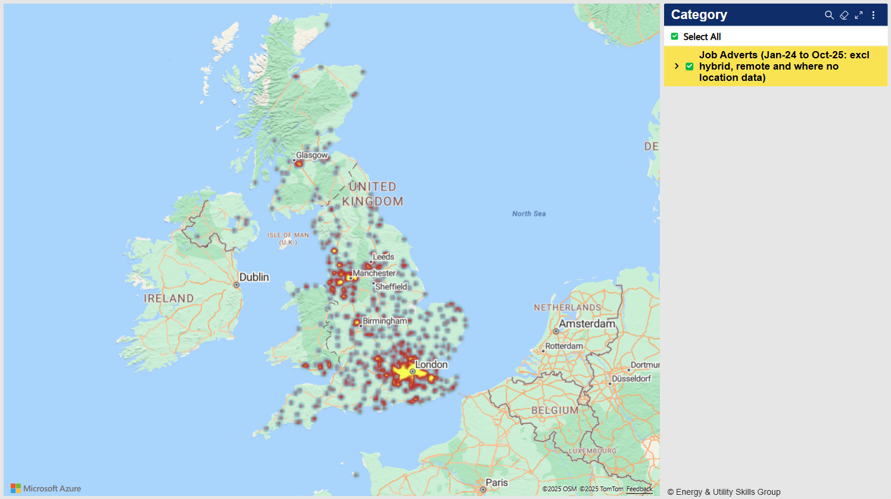
Current Coverage – Job Adverts Jan-24 to Octo-25
A total of 7,892 jobs have been advertised in 2025 YTD.
The mapping of job adverts is currently skewed by not being able to map roles that are hybrid, remote, and where no location data exists.
As such the mapping shows a far lower ‘intensity’ of roles than have been advertised.
UK wide reach and awareness demonstrated.

Slide 11
Potential ITT – Specialist Expertise
A Web Design & Development / CRO / SEO / Analytics & Insight company has been identified as being essential to lead on potential ITT documentation to enable a valid and reliable selection process to take place.
Fresh Egg have been appointed to deliver a potential ITT specification to enable the potential selection of a design and development partner (https://www.freshegg.co.uk/).

Slide 12
Introducing Fresh Egg
Fresh Egg are a strategic digital partner that combines user-centred design, content, and technical expertise to deliver collaborative solutions for complex, multi-stakeholder projects.
Phase | Focus | Key Outcomes
1. Facilitate and Lead Member, Partner and Government Workshop (19 Nov) | Structured, outcome-focused workshop with Energy & Utility Skills, partners, and government(s) | • Define audience needs and vision • Agree priorities, challenges, and success measures • Align on next-phase principles and outcomes to inform potneital ITT
2. Develop an Evidence-Based Potential ITT Pack | Build on workshop insights and existing materials (Vision deck, Skills Strategy 2025–2030) | • Create supporting materials for potential ITT, ready for supplier engagement
3. Outline Organisational & Potential ITT Goals | Clearly articulate purpose, audiences, and strategic context | • Concise summary of objectives to make potneital ITT compelling and informative
4. Potneital ITT Framework & Evaluation Criteria | Define fair, consistent partner assessment criteria | • Evaluate technical capability, UX design, delivery methods, collaboration, and indicative costs

Slide 13
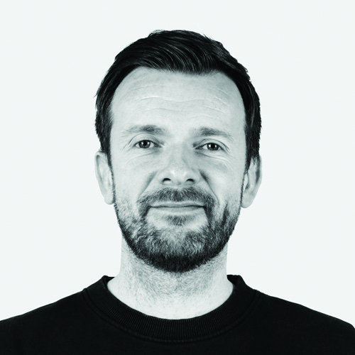
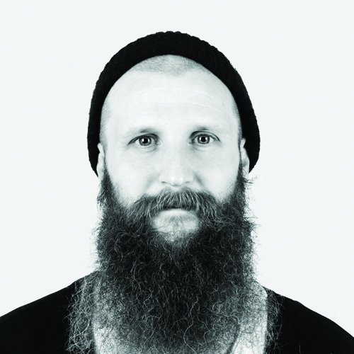

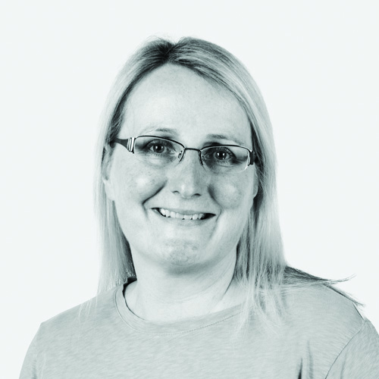
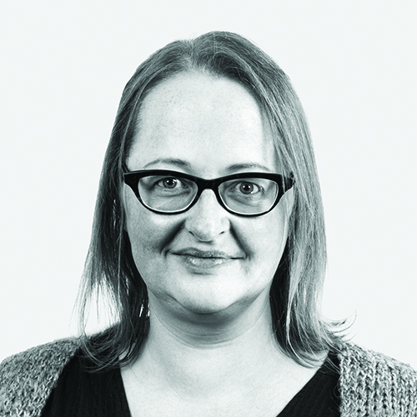
The Fresh Egg team
Name & Role | Expertise & Contribution
Stephen Carpenter - Head of Design | Enterprise-level UX and UI specialist with extensive experience leading collaborative design and workshop facilitation for complex digital projects.
Callum Grantham - Content Director | Expert in content design and strategy, ensuring language and structure meet both user and organisational needs.
June Robinson - Business Director | Brings significant experience managing large, multi-stakeholder projects and supporting facilitation at the workshop session.
Jo Pettett - Head of Web Operations | Manages our development team, bringing technical robustness to ensure the ITT reflects practical build considerations.
Sarah Tunstall - Chief Commercial Officer | Provides oversight on ITT compliance, governance, and contractual matters.

Slide 14
Timeline
POC WIP DRAFT
06.11 POC WIP document drafted and shared with EUS Group Board T&F group (LG, PV, PC, RT, LH).
06-11.11 POC WIP ‘feedback, query, challenge, criticism, ambition, and have you thought about’ from EUS Group Board T&F group (LG, PV, PC, RT, LH).
11.11 POC WIP feedback received from EUS Group Board T&F group.
12.11 POC WIP shared with industry group ahead of meeting at Microsoft HQ (location TBC).
From 13.11 early engagement notice / market engagement opportunity issued.
19.11 workshop in London (location TBC – likely Microsoft) with Web Design & Development / CRO / SEO / Analytics & Insight company leading on potential ITT documentation for a design and development partner present and leading.
20.11-11.12 ITT documentation drafted and completed by Web Design & Development / CRO / SEO / Analytics & Insight company leading on potential ITT documentation for a design and development partner .
11.12 ITT document work for a design and development partner completed and received – potential ITT document to enable an ‘apples’ / ‘apples’ scoring.
12.12 Final potential ITT launch preparation and internal comms.
WC 15.12 Pre ITT issue meeting of EUS Group Board T&F group (LG, PV, PC, RT, LH).
WC 15.12 ITT for a design and development partner issued after meeting of EUS Group Board T&F group.
14.01 ITT close at 23:59.
15.01 ITT administration and prepare for scoring.
16.01 ITT scoring completed.
19-20.01 Board papers drafted.
21.01 EUS Group Board papers sent to Board members.
28.01 EUS Group Board meeting and decision.

Slide 15
POC WIP Feedback
POC WIP DRAFT
Current Sector Alignment Example
A Memorandum of Understanding (MoU) for the Electricity Transmission Industry Collaboration on Skills and Workforce Planning has been drafted and signed by the three GB TOs.
The MoU will be signed by NG, SPEN and SSEN (completed). Suppliers that lead on the working groups and Energy & Utility Skills (we’re here now). Extend the offer to sign to the rest of the suppliers on the programme.
The MoU sets out our shared vision, mission, and principles for addressing skills shortages and workforce planning across the UK Electricity Transmission sector.
It reflects the collective commitment of GB Transmission Operators, supply chain partners, and Energy & Utility Skills to collaborate on tangible, measurable outcomes for the industry.
The MoU is intended as a statement of intent and is not legally binding, but it sets out clear principles for working together in good faith.
The eight points below are at the core of the MoU. Where marked green is where the vision and ambition of the POC WIP thinking wholly aligns. Yellow is where vision and ambition partially aligns.
1. Forecasting of Supply and Demand for key skills required to enable action to be taken in advance to avoid shortages that would lead to delays in project delivery.
2. Industry Attractiveness: Increasing the interest in and desirability of careers within the Electricity Transmission sector.
3. Role Standardisation: Standardising role descriptions and job functions across career pathways,
4. Performance and Accreditation: Further explore the scope for common performance standards and accreditations.
5. Exploring mechanisms by which to enable Reskilling / Movement of Skill from adjacent industry sectors (e.g. Oil & Gas)
6. Ensuring the Availability and Supply of sufficient UK Talent by ensuring sufficient education and training facilities, initiatives and programmes.
7. Removing Barriers to Expanding the Workforce: by making the sourcing of talent easier.
8. Speaking with one Voice: Agreeing joint communications that will have significantly greater impact when they are the views of all.

Slide 16
POC WIP Feedback
POC WIP DRAFT
National grid 28.10.25
Everyone is very supportive in terms of concept and ability for this to be a “game changer” and are keen to further explore the scope of this tool also being the sectors Skills Passporting system.
As with most large organisations the business can absolutely see the benefits but we need to consider that the business is also juggling many other significant projects so we will need very simple (but polished) PowerPoint Decks (target audience Snr Business Leaders / Finance) that can be used to share the link between the CEO Council sign off of our Sector Strategy, OFGEM requirements in T3 / ED3 etc / Networks Growth Plan … what the system will do, what is required from each business to make it happen, the benefits and timeline.
Scottish Power Energy Networks 31.10.25
We’re fully supportive of this initiative and it has our backing. The concept has real potential to be a significant step forward for the sector, and we’re keen to stay closely involved as it develops. The proposal reflects many of the enhancements we’ve been advocating for — particularly around automated role matching, vacancy integration, and platform ownership — and these developments give us confidence that the system will be scalable, user-friendly, and aligned with sector needs.
We believe EU Skills is best placed in the industry to lead the development and delivery of this platform, given your operational expertise and existing infrastructure. That alignment will be key to ensuring the tool delivers real value across the sector.

Slide 17
POC WIP Feedback
POC WIP DRAFT
Anglian Water 07.11.25
In principle, the introduction of this concept has the potential to help attract, retrain, retain, and redeploy within the sector, which is critical to ensure we have the right workforce and skills needed for the future.
TBC XX.XX.XX
…
Yorkshire Water 07.11.25
If marketed well reads like it could be helpful – using the Jobcentre connection would definitely get it off the starting blocks, but I’d expect it’d need sustained promotion beyond the site/platform, which would need to be factored in to avoid the risk of developing a something great that doesn’t receive the traffic expected.
Probably some sharing that could be included with other bodies as a route in (industry, professional, ex-forces transition support teams etc) as a starter.

